Slide 1
Large vocabulary ASR
Most slides come from http://www.inf.ed.ac.uk/teaching/courses/asr/2020-21/asr05-hmm-algorithms.pdf
Ying shen
School of software engineering
Tongji university

Slide 2
HMM Speech Recognition
Decoded Text
(Transcription)
Recorded Speech
Signal Analysis
Acoustic Model
Search Space
Language Model
Training Data

Slide 3
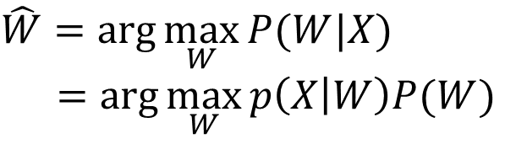
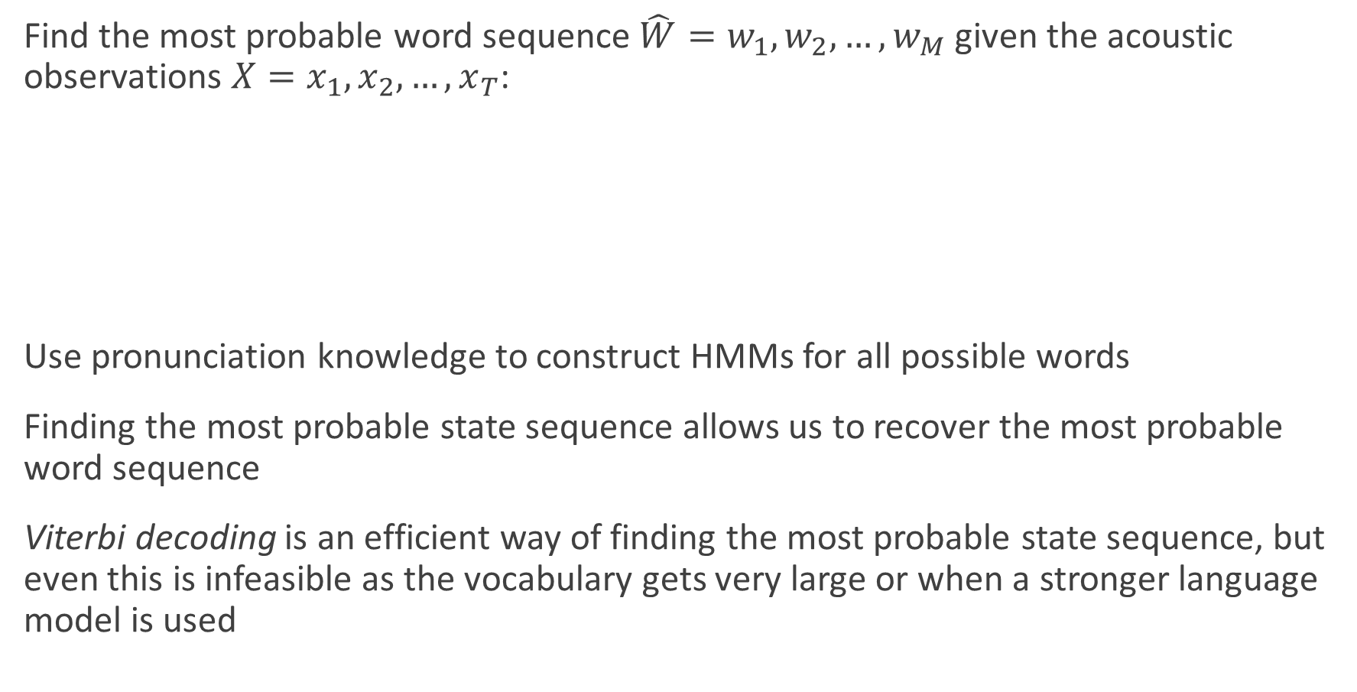
The Search Problem in ASR
Find the most probable word sequence $\hat{W}=w_{1},w_{2},…,w_{M}$ given the acoustic observations $X=x_{1},x_{2},…,x_{T}$:
Use pronunciation knowledge to construct HMMs for all possible words
Finding the most probable state sequence allows us to recover the most probable word sequence
Viterbi decoding is an efficient way of finding the most probable state sequence, but even this is infeasible as the vocabulary gets very large or when a stronger language model is used
$$\hat{W}=\arg{\max_{W}{P(W|X)}}$$
$$=\arg{\max_{W}{p\left(X | W\right)P(W)}}$$
Acoustic model
Language model

Slide 4
Recap: the word HMM
HMM naturally generates an alignment between hidden states and observation sequence
r1
r2
r3
ai1
ai2
ai3
t1
t2
t3
/r/
/ai/
/t/
“right”

Slide 5
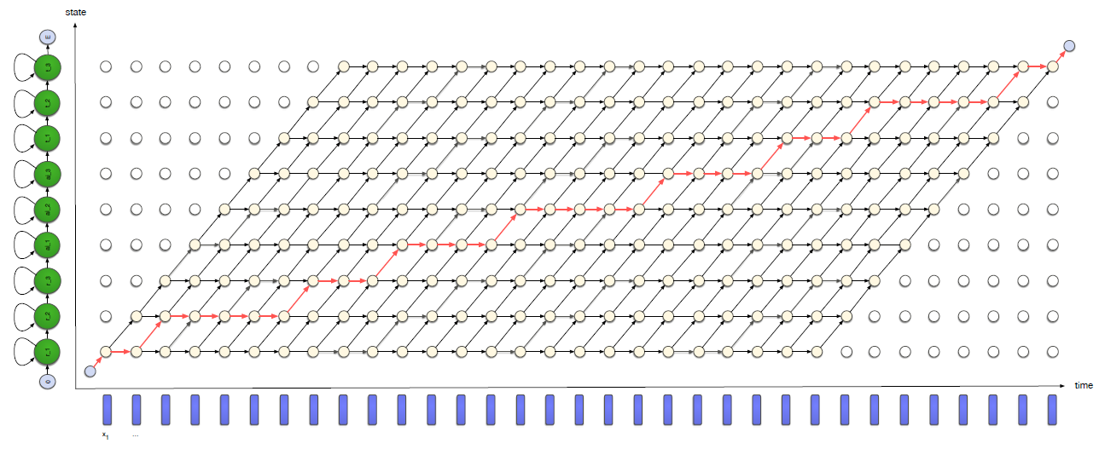

Viterbi algorithm for state alignment
Viterbi algorithm finds the best path through the trellis - giving the highest $p(X,Q)$.

Slide 6









Simplified version with one state per phone
state
$$E$$
r
ai
t
$$0$$
time
$$x_{1}$$
$$x_{2}$$
$$x_{3}$$
$$x_{4}$$
$$x_{5}$$
$$x_{6}$$
$$x_{7}$$

Slide 7
Isolated word recognition
“right”
r
ai
t
“ten”
0
t
eh
n
E
p
ih
n
“pin”

Slide 8
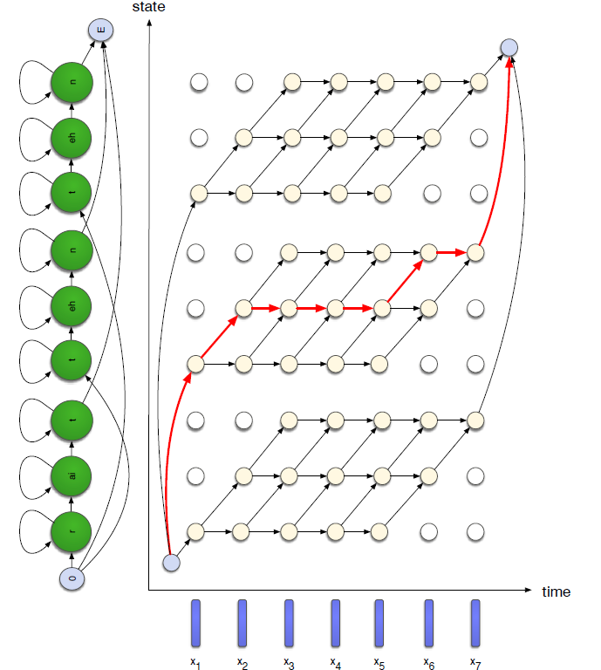
Viterbi algorithm: isolated word recognition
Viterbi algorithm: isolated word recognition

Slide 9

Connected word recognition
Even worse when recognizing connected words...
The number of words in the utterance is not known
Word boundaries are not known: any of the $V$ words may potentially start at each frame.

Slide 10
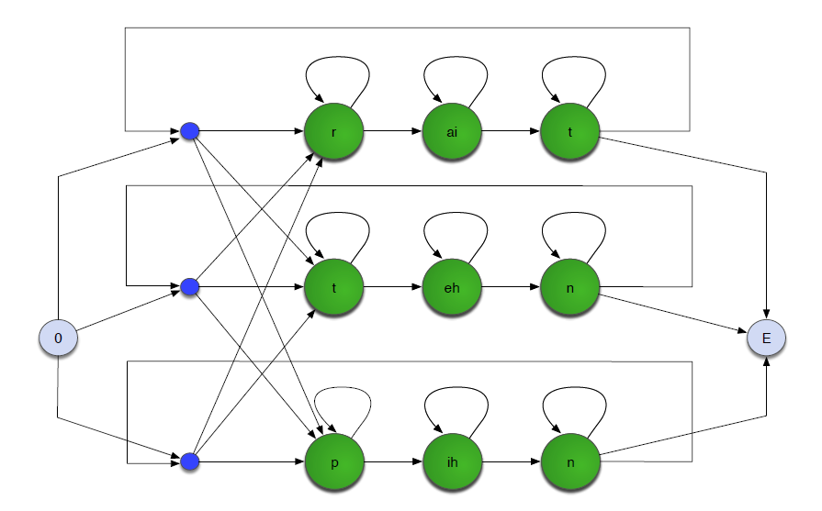
Connected word recognition

Slide 11
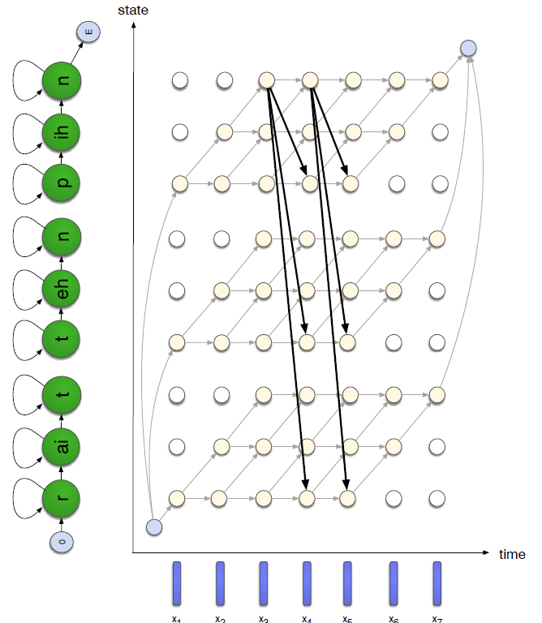
Viterbi algorithm: connected word recognition
Add transitions between all word-final and word-initial states

Slide 12
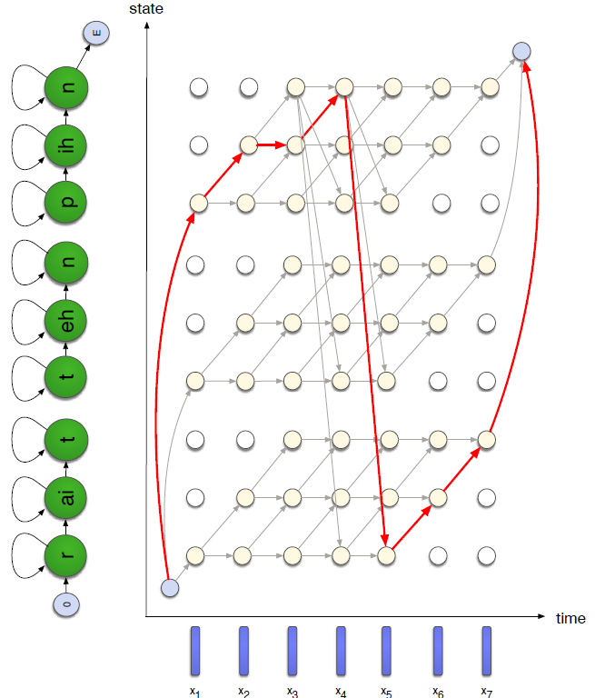
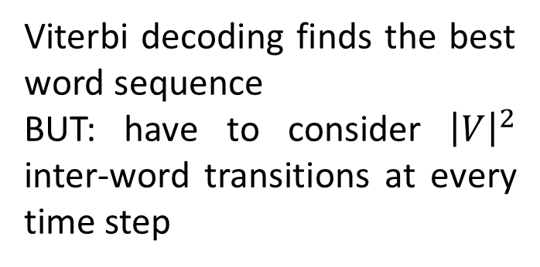
Connected word recognition
Viterbi decoding finds the best word sequence
BUT: have to consider ${\left|V\right|}^{2}$ inter-word transitions at every time step

Slide 13
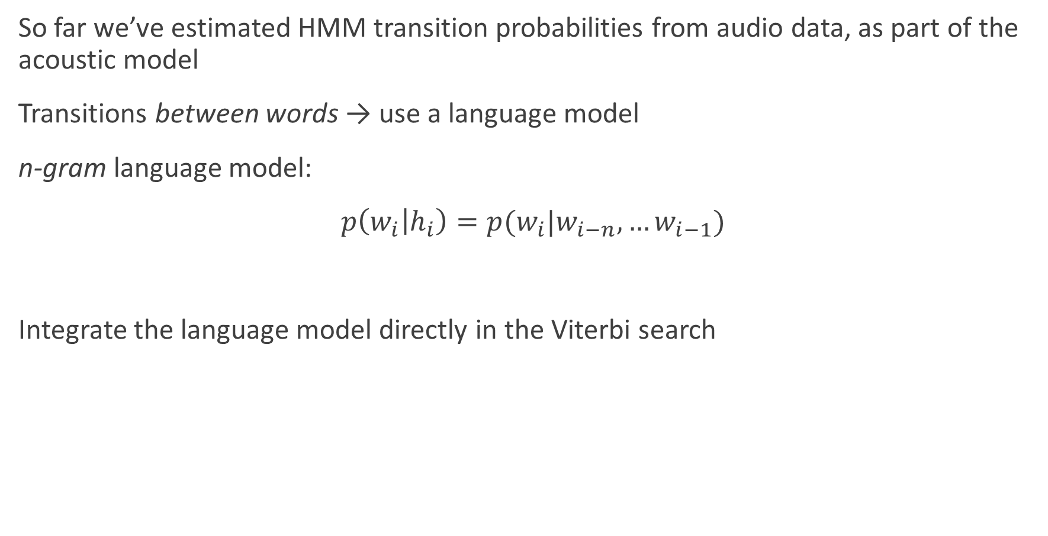
Integrating the language model
So far we’ve estimated HMM transition probabilities from audio data, as part of the acoustic model
Transitions between words → use a language model
n-gram language model:
$p\left(w_{i} | h_{i}\right)=p(w_{i}|w_{i−n},…w_{i−1})$
Integrate the language model directly in the Viterbi search

Slide 14
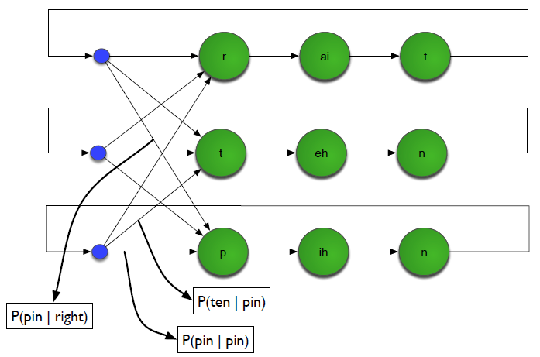
Incorporating a bigram language model

Slide 15
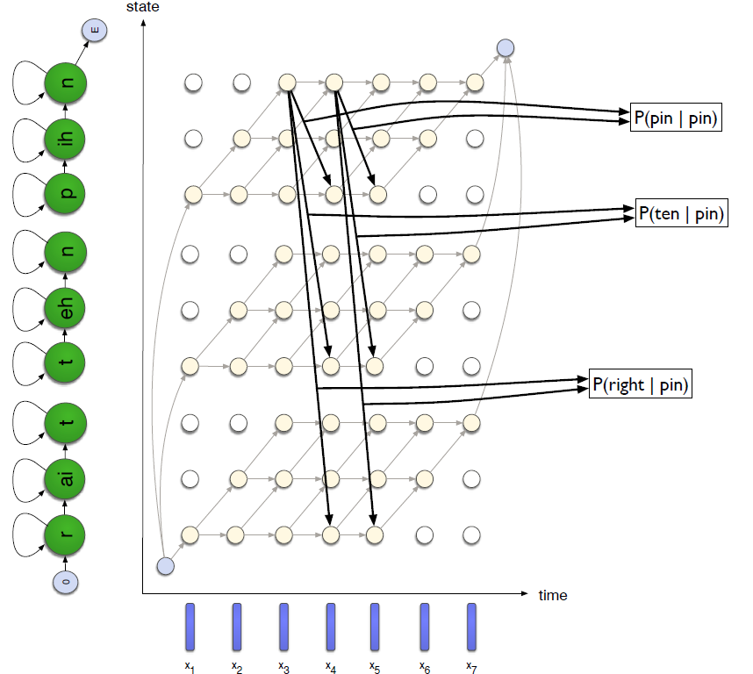
Incorporating a bigram language model

Slide 16
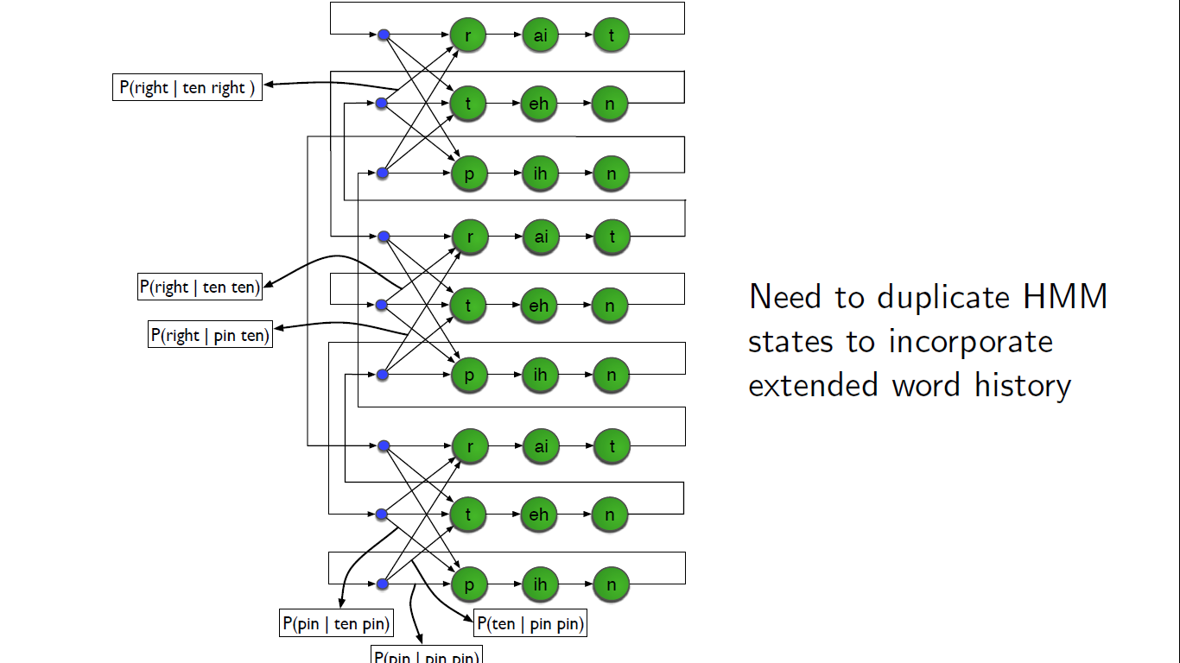
Incorporating a trigram language model

Slide 17
Computational Issues
Viterbi decoding performs an exact search in an efficient manner
But exact search is not possible for large vocabulary tasks
Long-span language models and the use of cross-word triphones greatly increase the size of the search space
Solutions:
Beam search (prune low probability hypotheses)
Tree structured lexicons
Language model look-ahead
Dynamic search structures
Multipass search (→ two-stage decoding)
Best-first search (→ stack decoding / A* search)
Next lecture: an alternative approach using weighted finite state transducers (WFSTs)

Slide 18
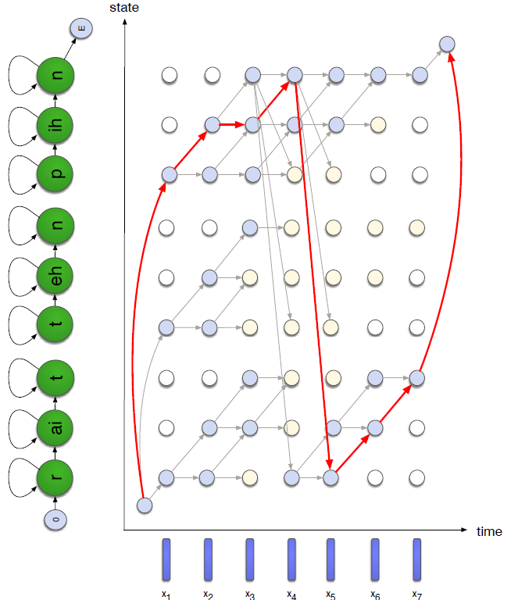
Pruning
During Viterbi decoding, don't propagate tokens whose probability falls a certain amount below the current best path
Result is only an approximation to the best path

Slide 19
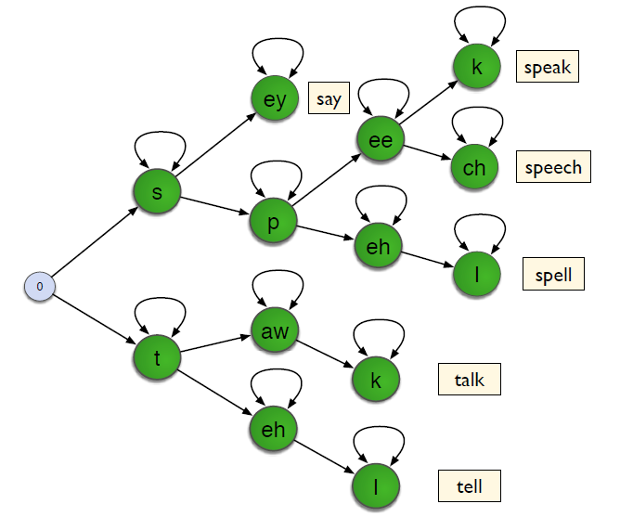
Tree-structured lexicon
Figure adapted from Ortmans & Ney, “The time-conditioned approach in dynamic programming search for LVCSR”

Slide 20
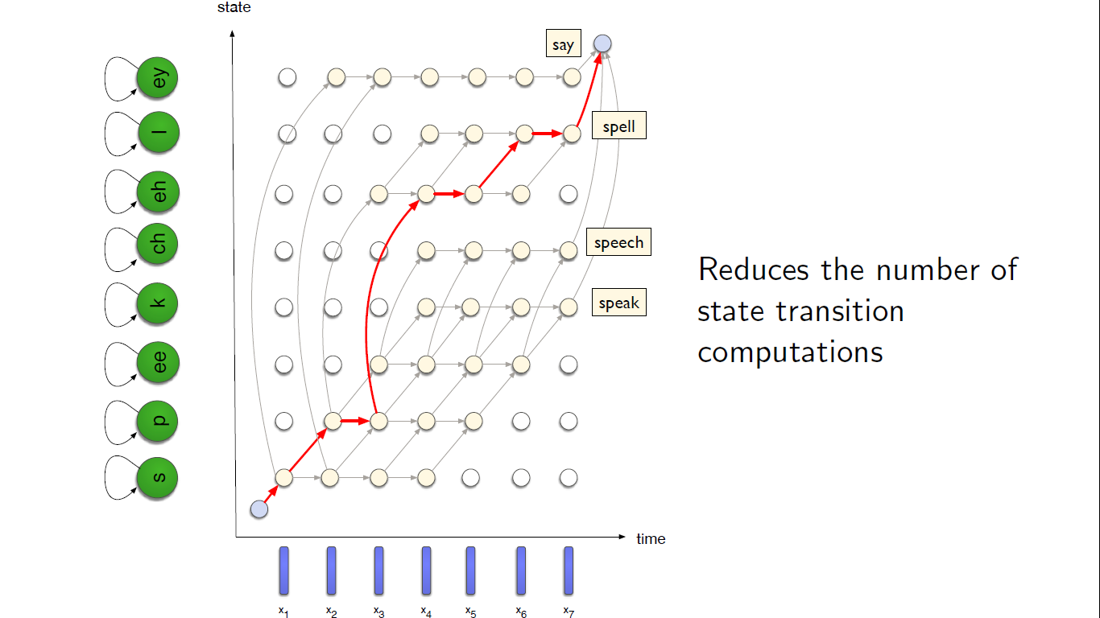
Tree-structured lexicon

Slide 21
Language model look-ahead
Aim to make pruning more efficient
In tree-structured decoding, look ahead to find out the best LM score for any words further down the tree
This information can be pre-computed and stored at each node in the tree
States in the tree are pruned early if we know that none of the possibilities will receive good enough probabilities from the LM.

